Slide 1
3D Scanning and Spatial Learning Multi-view 4D Volumetric Fusion
Marcel Bruckner, Kevin Bein, Moiz Sajid

Slide 2
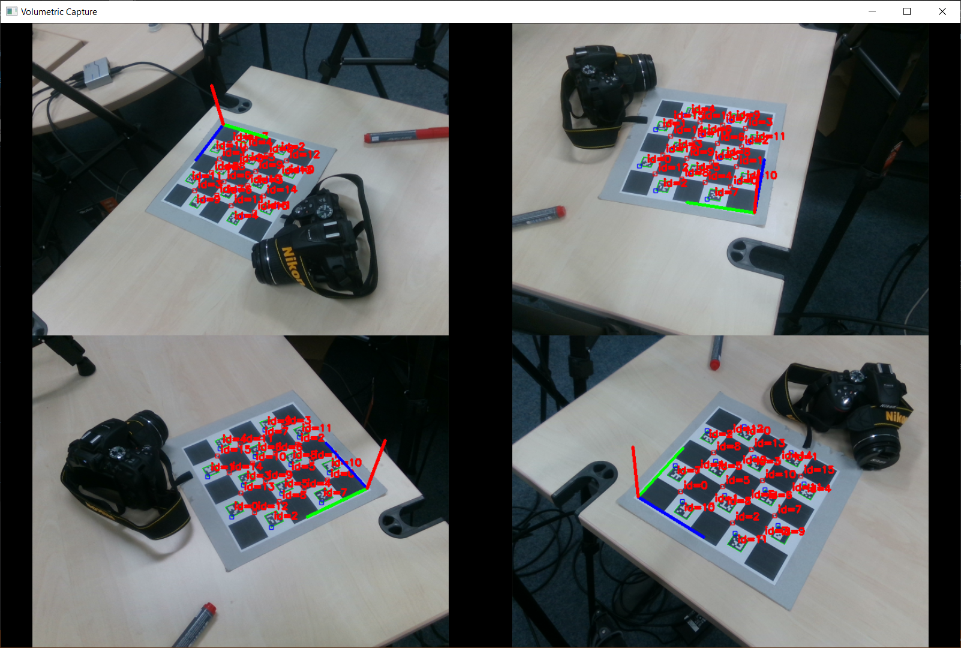
Current state – Done

Slide 3
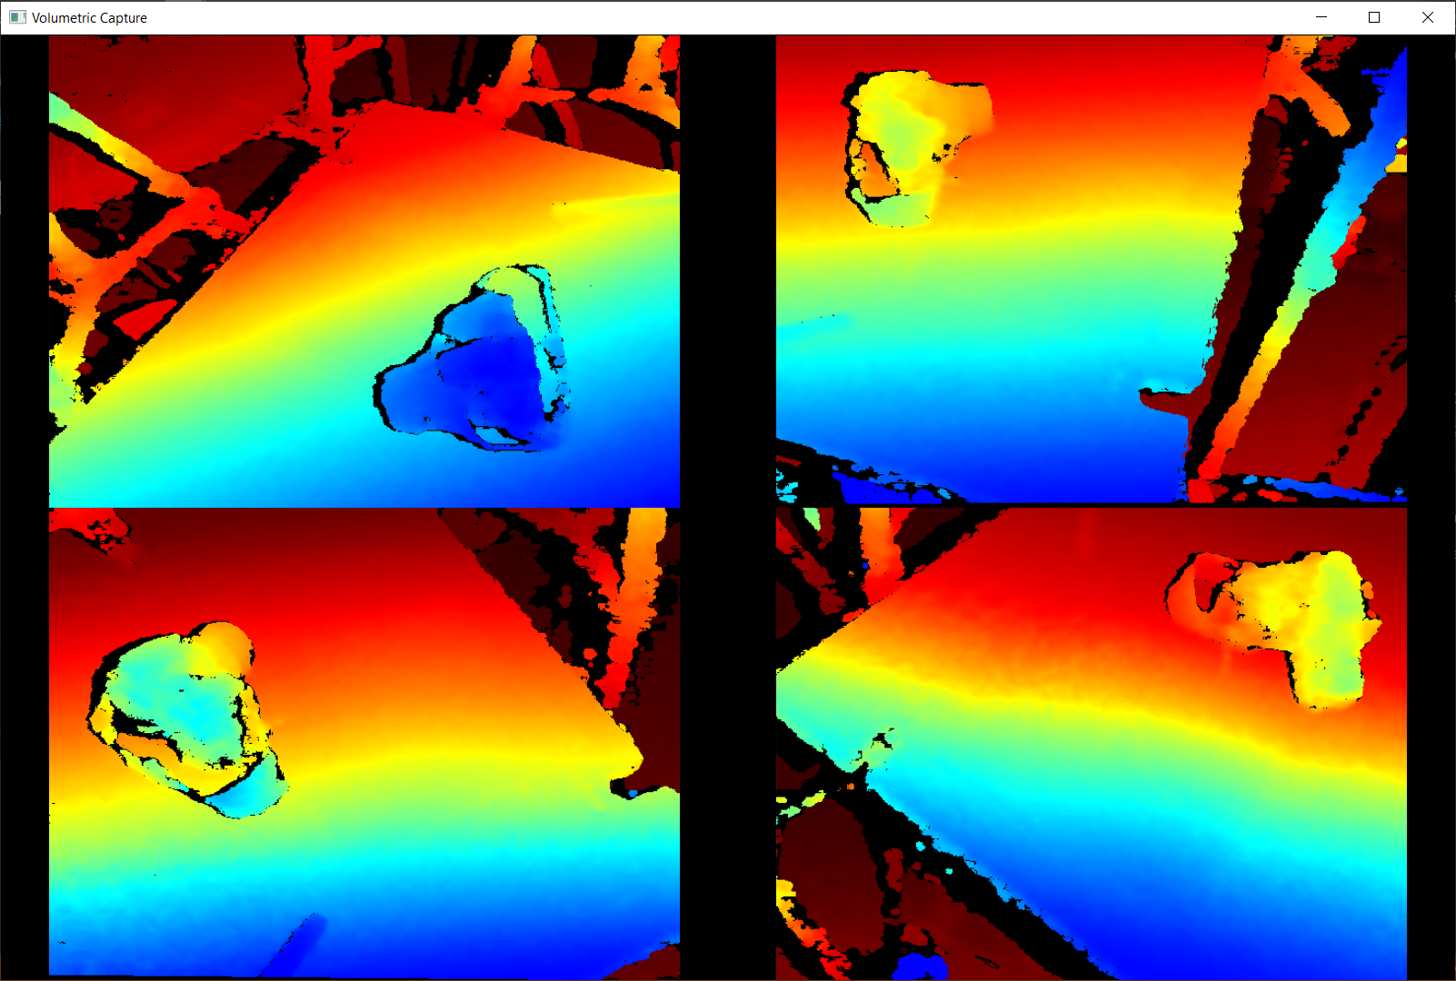
Current state – Done

Slide 4
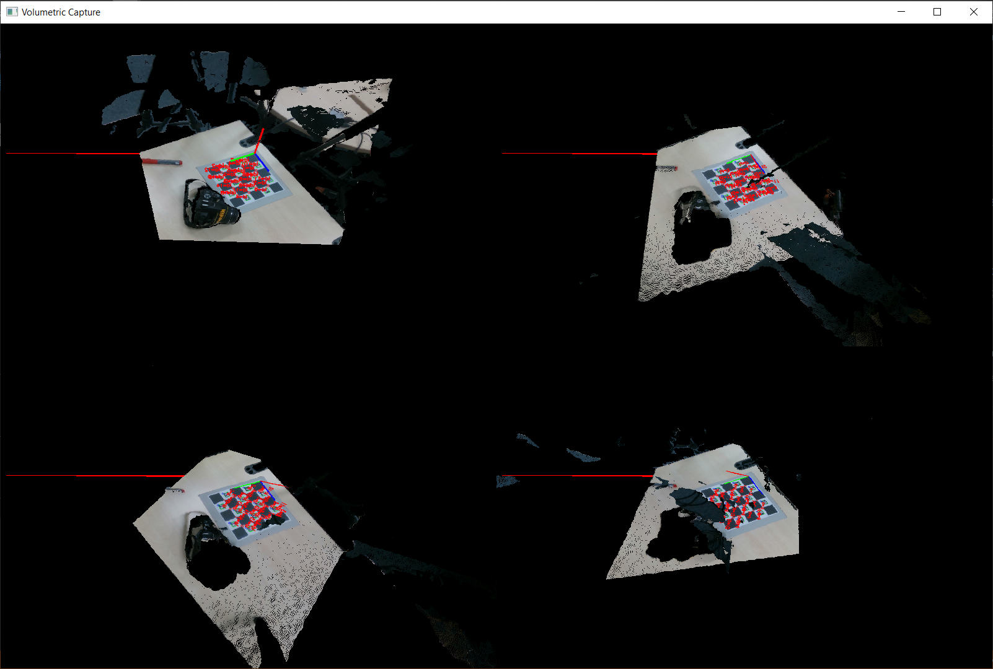
Current state – Done

Slide 5
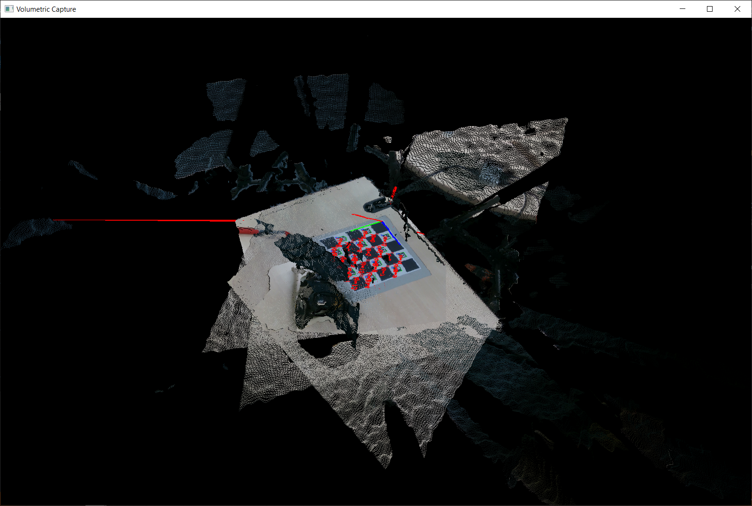
Current state – Done

Slide 6
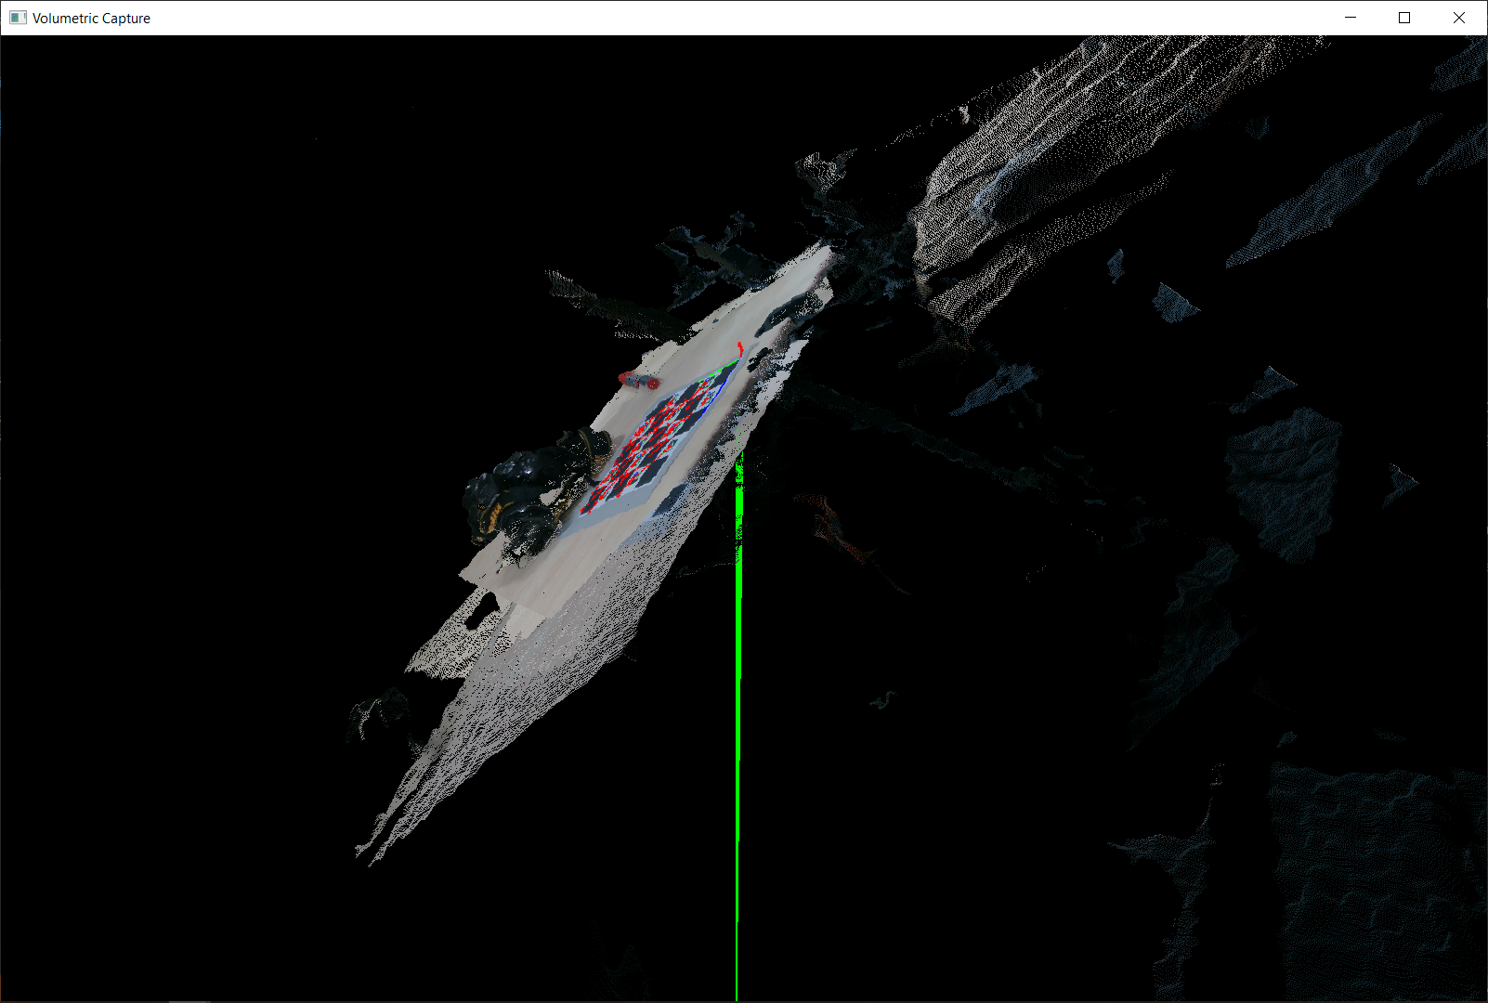
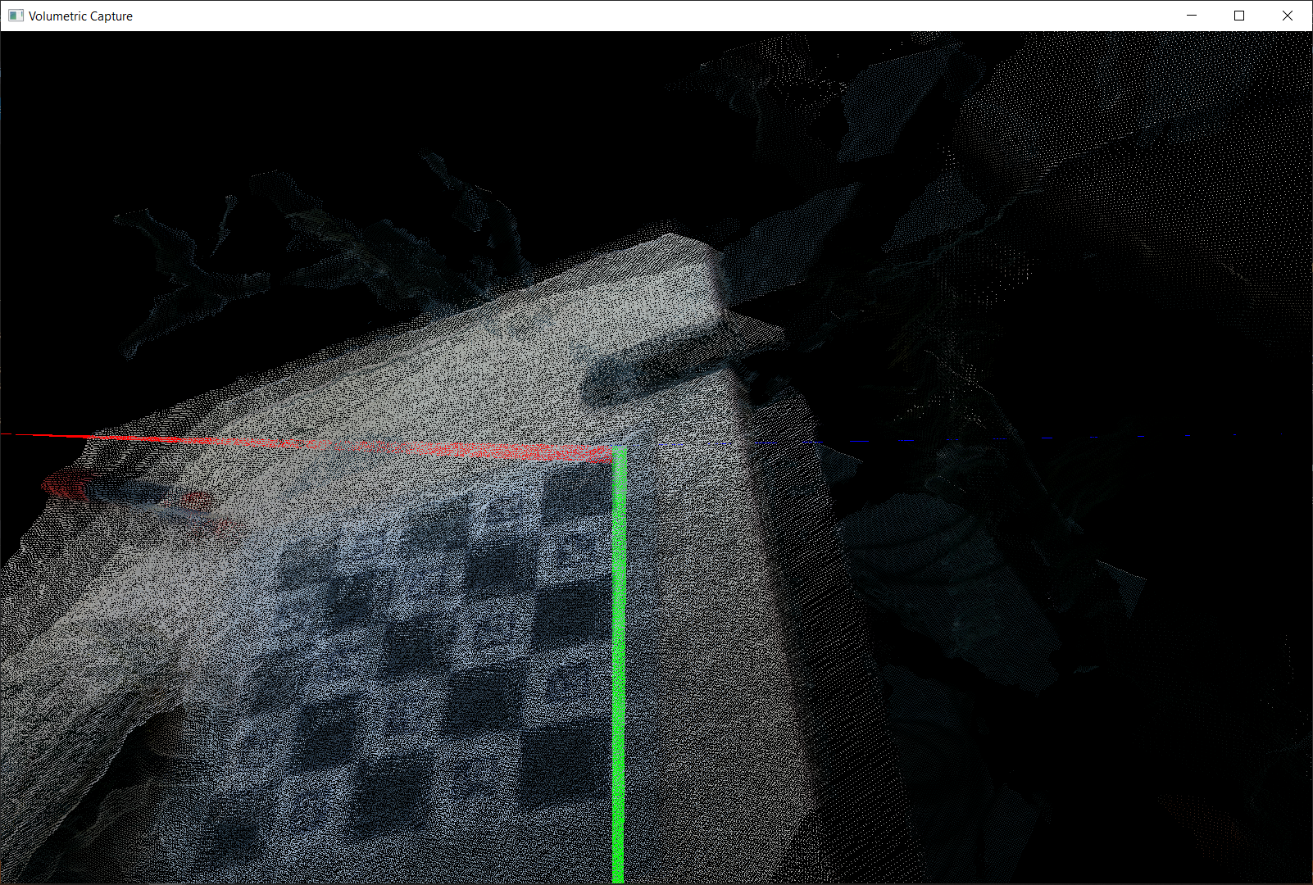
Current state – Done

Slide 7
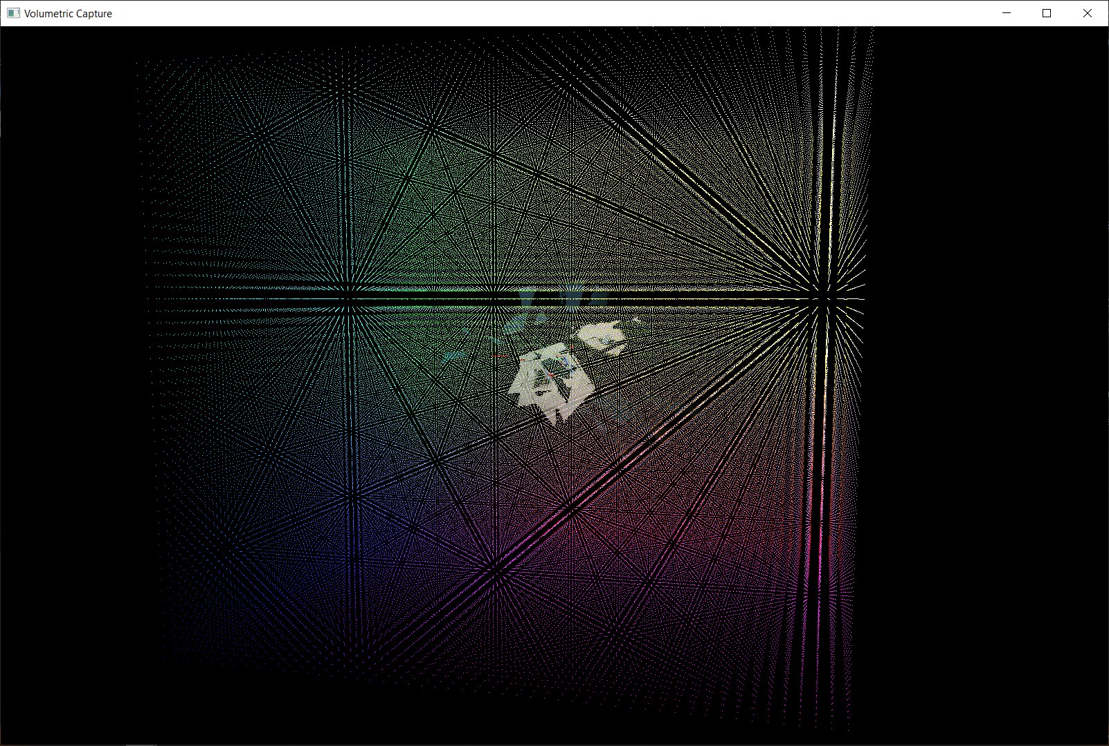
Current state – In progress

Slide 8
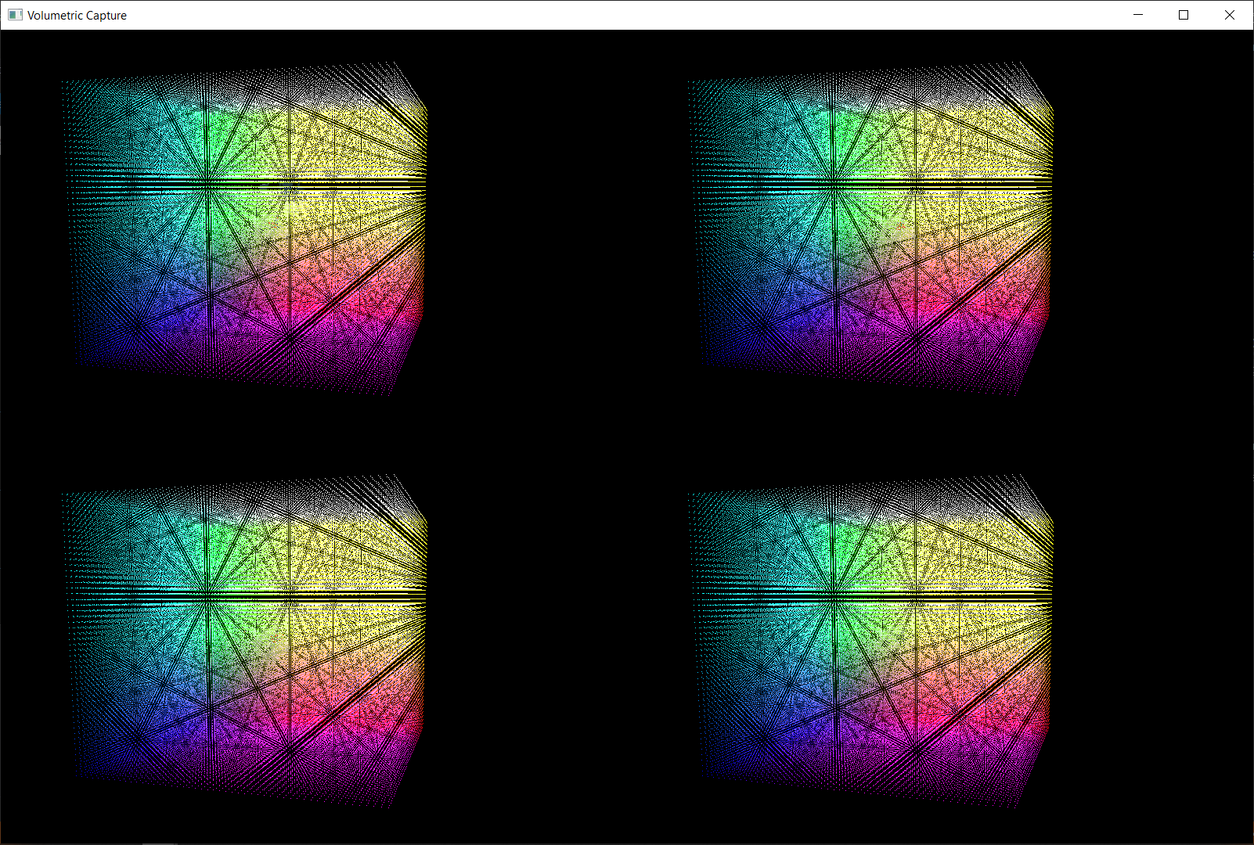
Current state – In progress

Slide 9
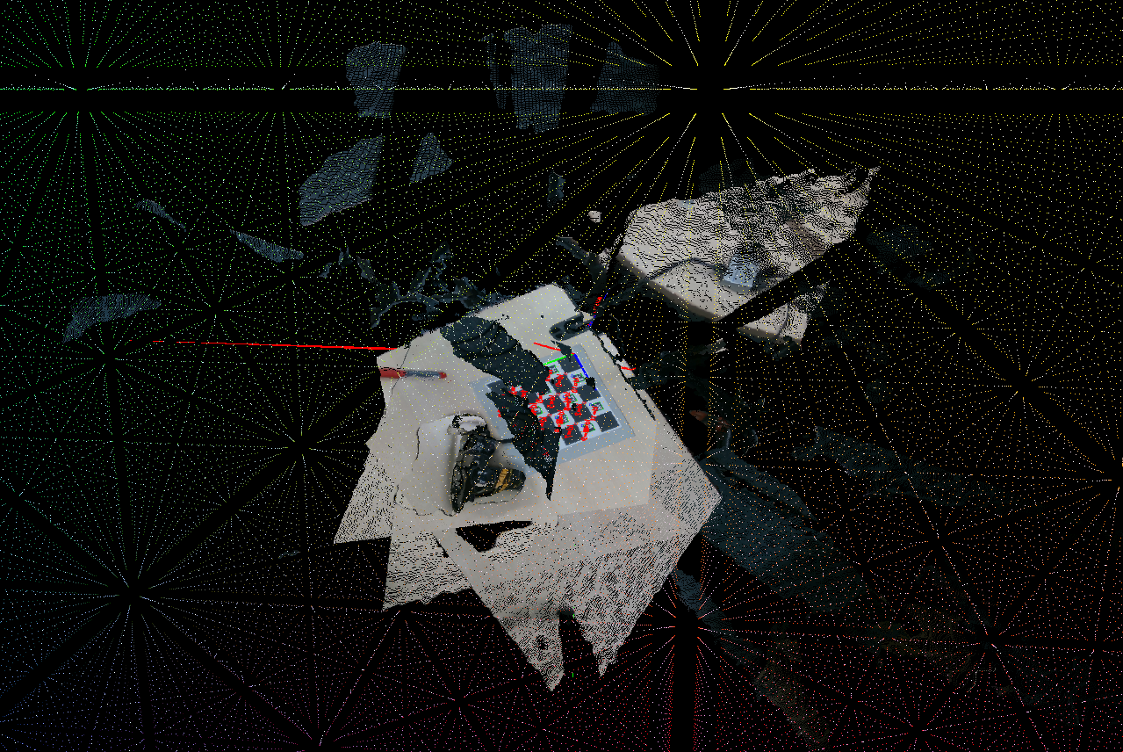
Current state – In progress

Slide 10
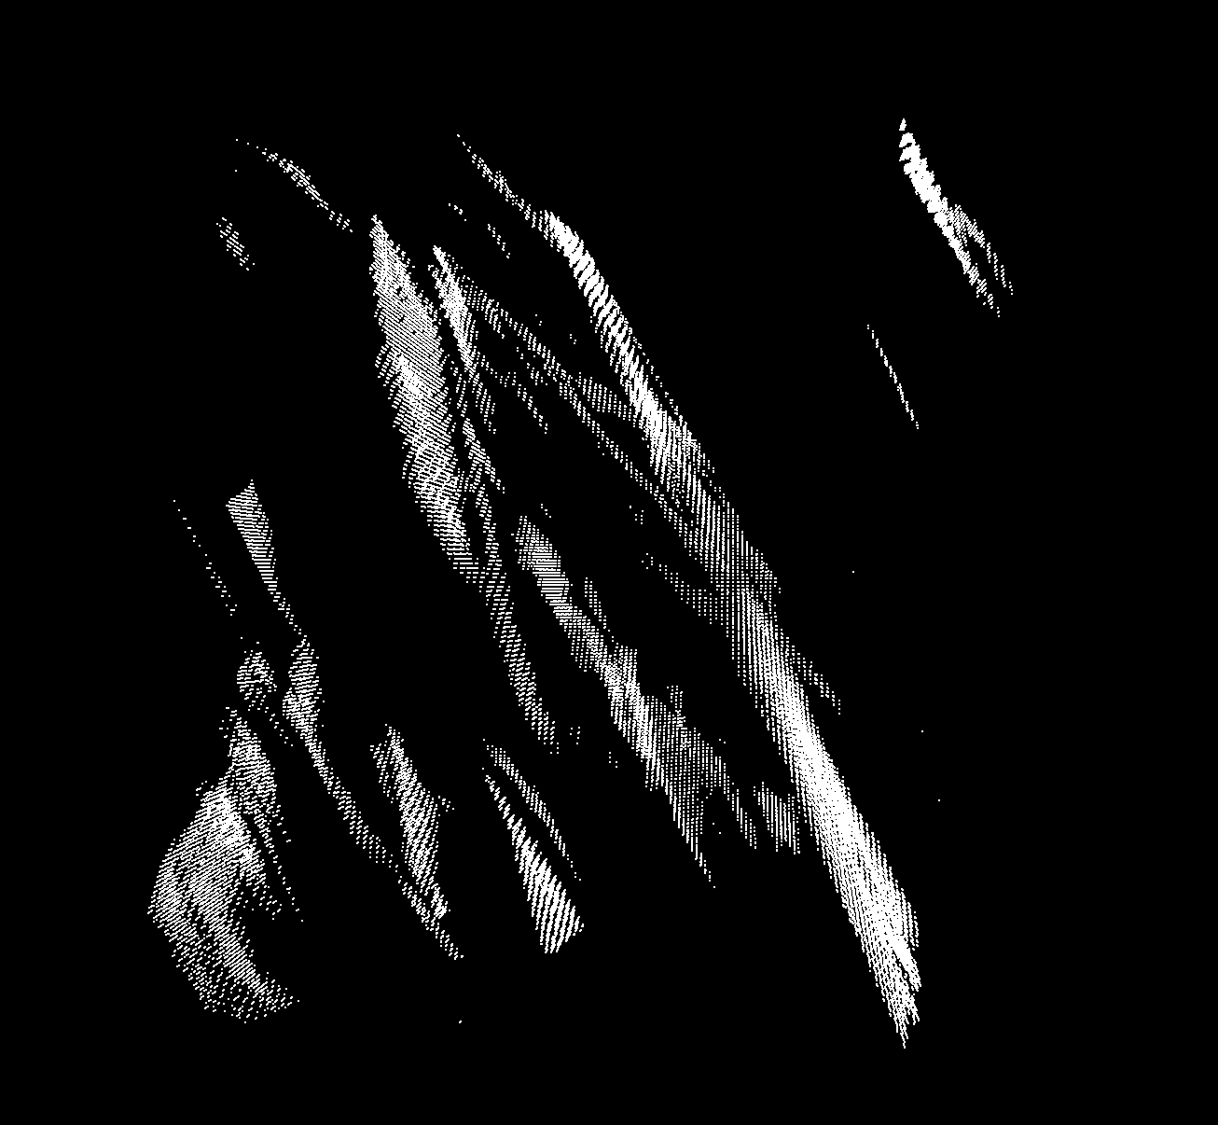
Current state – In progress

Slide 11
Project Milestones
Volumetric Fusion
12.2019
Camera setup
10.2019
Camera calibration
Most of 11.2019
Optimization
01.2020
Preprocessing
10.2019
Rigid alignment
End 11.2019
Non-rigid Tracking
01.2020

Slide 12
Current state – In progress
Volumetric Fusion
GPGPU implementation of voxelgrid / tsdf
Marching cubes for extraction of isosurface

Slide 13
Thank you!

